Slide 1
E-Commerce Database System
Yu-Jiun Kao
Yu-Hui Wu

Slide 2
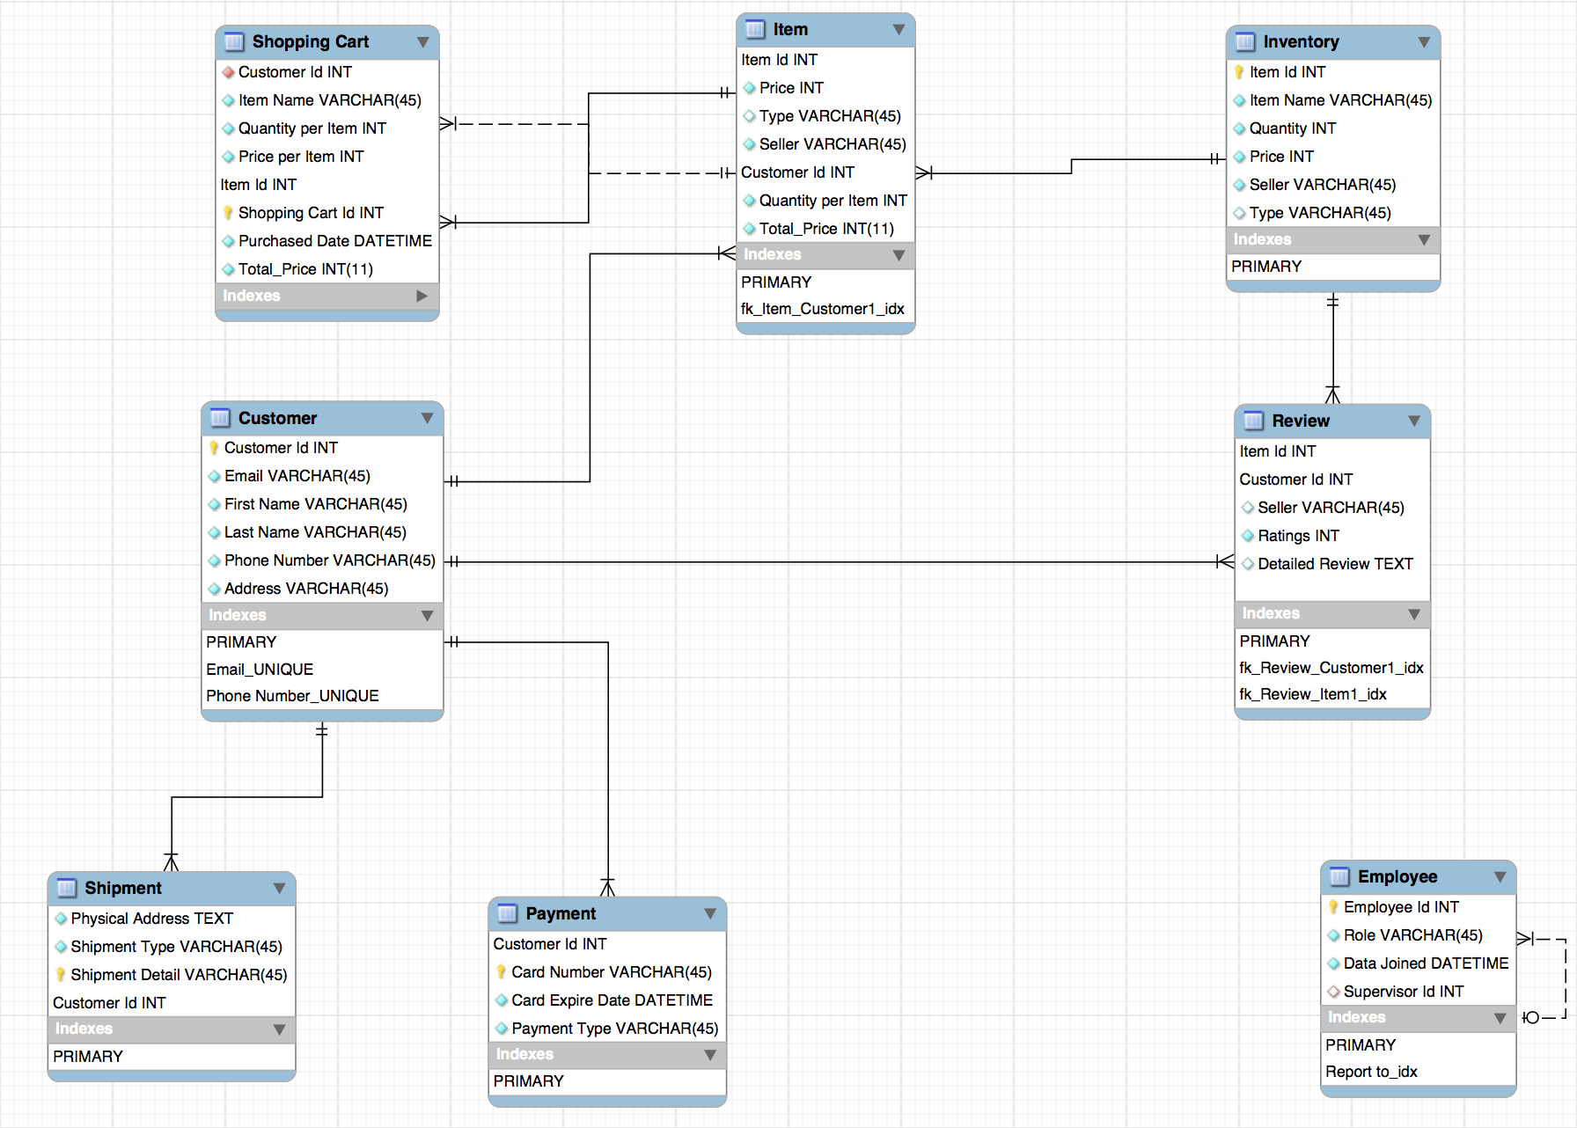
E-R Diagram

Slide 3
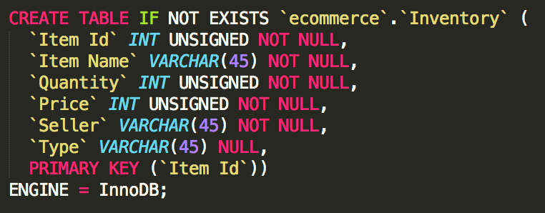
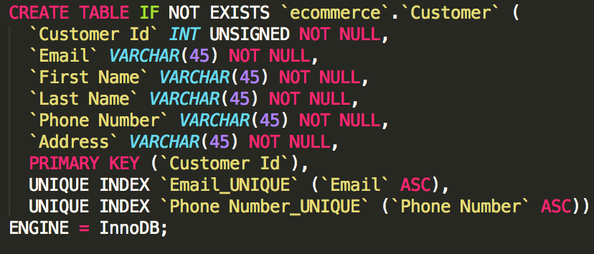
MYSQL
Inventory
Customer

Slide 4
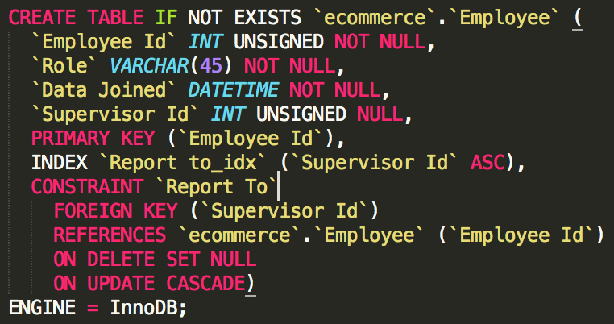
MYSQL
Employee

Slide 5
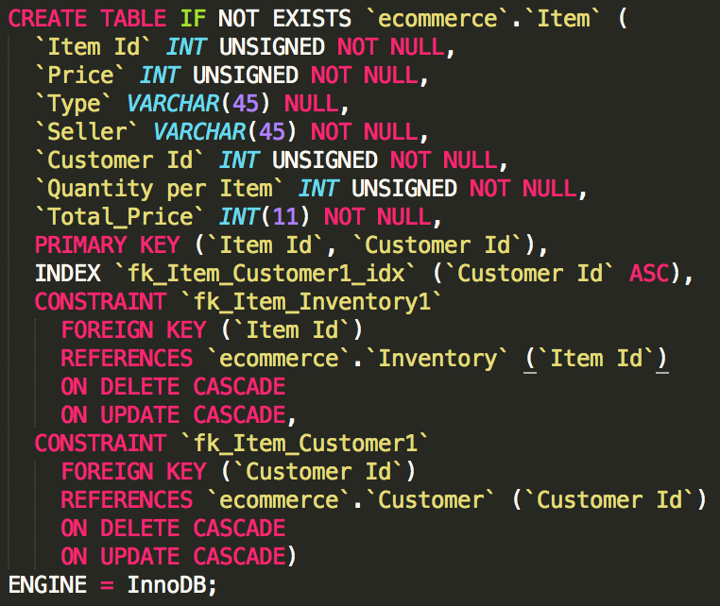
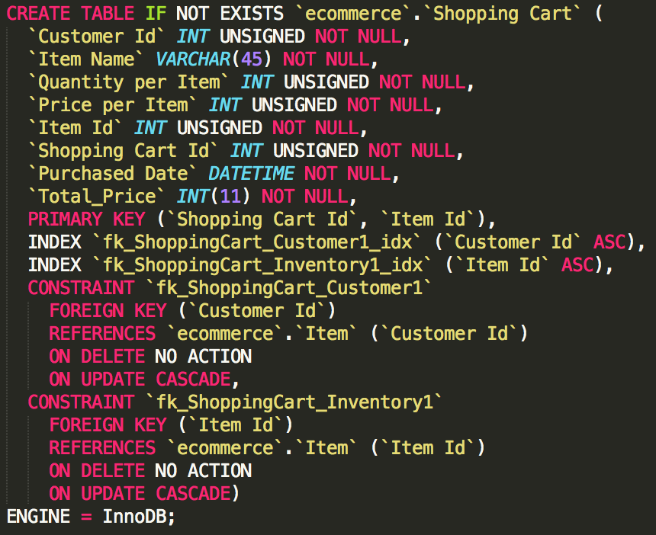
Foreign Key Constraints
Item (Cart)
Shopping Cart (Order)

Slide 6
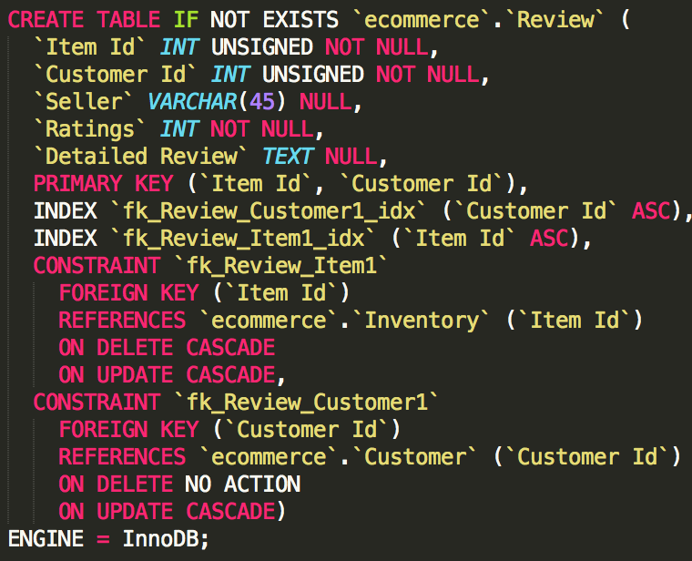
Foreign Key Constraints
Review

Slide 7
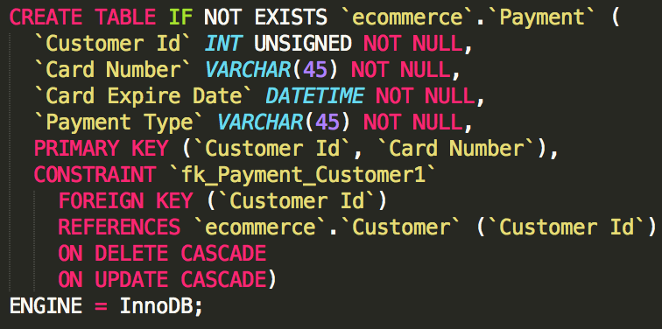
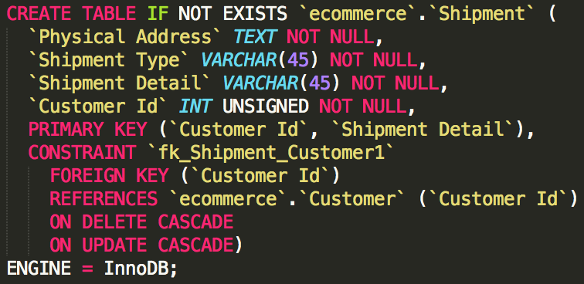
Foreign Key Constraints
Payment
Shipment

Slide 8
Contribution
We did the project all together from the beginning (Assignment 1) to the very end.
Hard to define the subtle difference of workload between each person
Yu-Jiun Kao: 50%
Yu-Hui Wu: 50%

